Slide 1
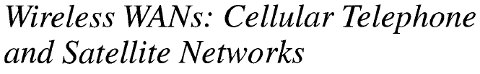
Cellular Telephony
Satellite Networks

Slide 2
Cellular Telephony(1)
to provide communications between two moving units, called mobile stations
(MSs), or between one mobile unit and one land line unit.
Cellular service area is divided into small regions called cells.
Cell size is not fixed and can be increased or decreased depending on the population of the area.
Typical radius of a cell is 1 to 12 mi.
Each cell contains an antenna and is controlled by a base station (BS).
Each base station, in turn, is controlled by a switching office, called a mobile
switching center (MSC).

Slide 3
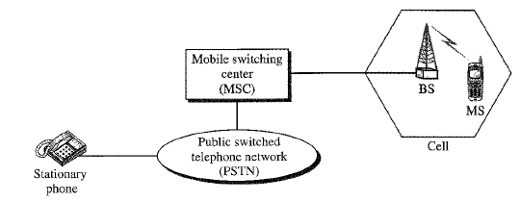
Cellular Telephony(2)
MSC coordinates communication between all BSs and the telephone central office.
MSC is a computerized center that is responsible for connecting calls, recording
call information, and billing.
A service provider must be able to locate and track a caller, assign a channel to the call, and transfer the channel from one BS to another BS as the caller moves out of range.
Cellular System

Slide 4
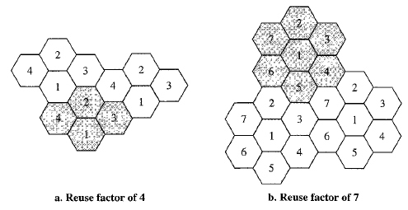
Cellular Telephony(3)
Frequency – Reuse Principle
In general, neighboring cells cannot use the same set of frequencies for communication because it may create interference for the users located near the cell boundaries. However, the set of frequencies available is limited, and frequencies need to be reused.
A frequency reuse pattern is a configuration of N cells, N being the reuse factor, in which each cell uses a unique set of frequencies.
When the pattern is repeated, the frequencies can be reused.
Cells using the same set of frequencies are called reusing cells.

Slide 5
Cellular Telephony(4)
Trasnmitting
The MS always connects to a strong setup channel provided by its service provider.
To place a call from a MS, the caller enters a phone number and presses the send button. Then this data (phone number) is sent to the closest BS using setup channel.
The BS relays the data to the MSC.
The MSC sends the data onto the telephone central office if the called party is a landline number. If the called party is available, a connection is made and the result is relayed back to the MSC.
MSC assigns an unused voice channel to the call if the called party is available, and a connection is established.
The MS automatically adjusts its tuning to the new channel, and communication can begin.
Receiving
When a MS is called, the telephone central office sends the number to the MSC, if the calling party is a landline number.

Slide 6
Cellular Telephony(5)
The MSC searches for the location of the MS by sending query signals to each cell in a process called paging.
Once the MS is found, the MSC transmits a ringing signal and, when the MS answers, assigns a voice channel to the call, allowing voice communication to begin.
Handoff
When a MS moves from one cell to another, the signal may become weak.
To solve this problem, the MSC monitors the level of the signal every few seconds. If the strength of the signal diminishes, the MSC seeks a new cell that can better accommodate the communication. The MSC then changes the channel carrying the call (hands the signal off from the old channel to a new one).
Hard Handoff (Early systems used): a MS only communicates with one BS. When the MS moves from one cell to another, communication must first be broken with the previous BS before communication can be established with the new one.
Soft Handoff (New systems): a MS can communicate with two BSs at the same time. This means that, during handoff, a MS may continue with the new BS before breaking off from the old one.

Slide 7
Cellular Telephony(6)
Roaming
One feature of cellular telephony is called roaming.
Roaming means that a user can have access to communication or can be reached where there is coverage.
A service provider usually has limited coverage. Neighbouring service providers can provide extended coverage through a roaming contract.

Slide 8
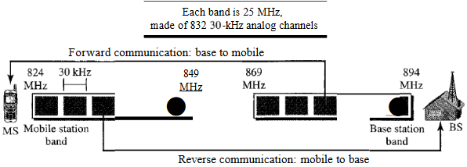
Generations of Cellular Telephony
First Generation
Was designed for voice communication using analog signals
AMPS (Advanced Mobile Phone System)
  first-generation mobile system used in North America.
  It is an analog cellular phone system using FDMA
  Operates in the 800-MHz band
  Uses two separate analog channels, one for forward (BS to MS) communication and one for reverse (MS to BS) communication.
  Frequency reuse factor: 7
  21 channels for control
Cellular bands for AMPS

Slide 9
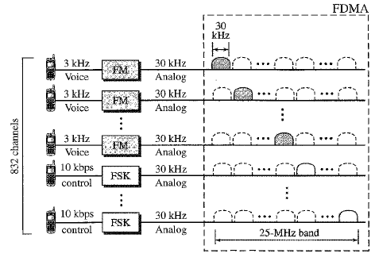
AMPS reverse communication band

Slide 10
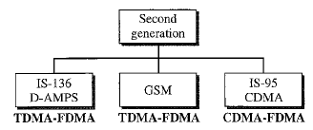
Second Generation
Designed for digitized voice.
Second-generation cellular phone systems

Slide 11
D-AMPS (Digital AMPS)
Evolution of the analog AMPS into a digital system is digital AMPS.
backward compatible with AMPS.
Defined by IS-54 (Interim Standard 54) and later revised by IS-136.
Same bands and channels as AMPS.
Each voice channel is digitized using a very complex PCM and compression technique. A voice channel is digitized to 7.95kbps. Three 7.95-kbps digital voice channels are combined using TDMA. The result is 48.6kbps of digital data; much of this is overhead.
25 frames/sec on each channel, with 1944 bits per frame.
6 slots per frame.
2 slots per station.
The resulting 48.6kbps of digital data modulates a carrier using QPSK; the result is a 30-kHz analog signal.
D-AMPS, or IS-136 is a digital cellular phone system using TDMA and FDMA.

Slide 12
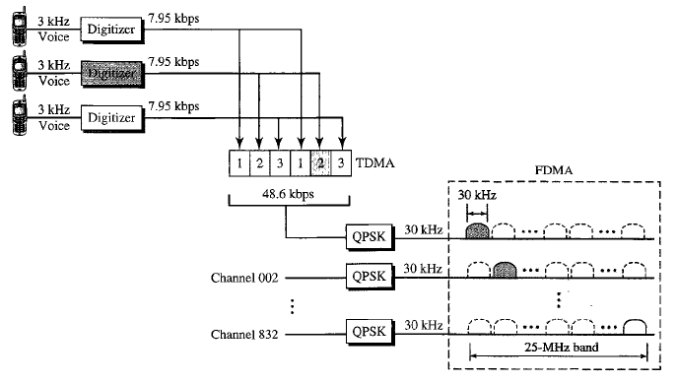
D-AMPS

Slide 13
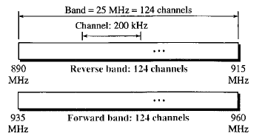
GSM (Global System for Mobile Communication)
European standard
Aimed to replace a no. of incompatible first-generation technologies.
is a digital cellular phone system using TDMA and FDMA.
Shifted to 900 MHz band.
Channels are separated by guard bands.
Each voice channel is digitized and compressed to a 13-kbps digital signal. Eachslot carries156.25 bits.
Eight slots share a frame (TDMA).
26 frames also share a multiframe (TDMA).
Reuse factor: as low as 3
GSM bands

Slide 14
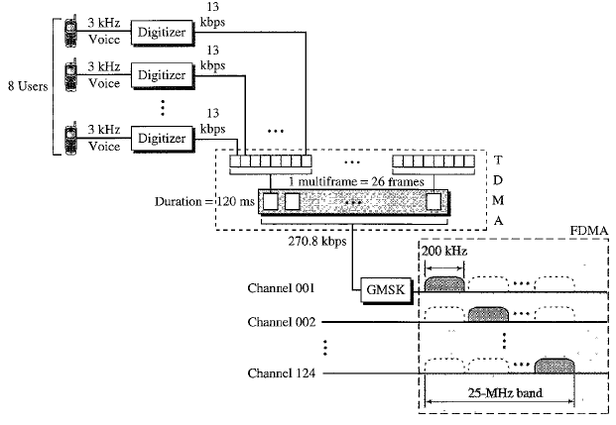
Each 270.8kbps digital channel modulates a carrier using GMSK; the result is a 200kHz analog signal.
Finally 124 analog channels of 200kHz are combined using FDMA.
GSM

Slide 15
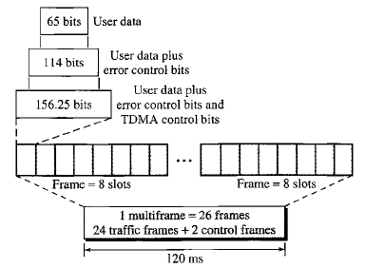
Multiframe Components

Slide 16
IS – 95
Digital cellular phone system based on CDMA/DSSS and FDMA.
Uses two bands: 800-MHz or 1900-MHz band. Each band is divided into 20 channels of 1.228 MHz separated by guard bands.
All base channels need to be synchronized to use CDMA. To provide this, bases use the services of GPS (Global Positioning System).
Has two different transmission techniques: one for use in the forward direction and another for use in the reverse direction.
Each voice channel is digitized, producing a basic data rate of 9.6kbps. After adding error-correcting, repeating, and interleaving bits, the result is a signal of 19.2ksps (kilo signals per second). This output is now scrambled using a 19.2ksps signal. The scrambling signal is produced from a long code generator that uses the electronic serial number (ESN) of the MS and generates 2⁴² pseudorandom chips, each chip having 42 bits. The output of the long code generator is fed to a decimator, which chooses 1 bit out of 64 bits. The output of the decimator is used for scrambling. The scrambling is used to create privacy; the ESN is unique for each station.

Slide 17
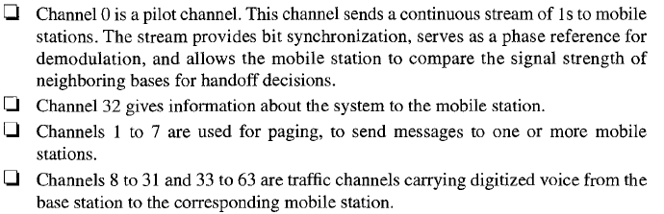
The result of the scrambler is combined using CDMA. For each traffic channel, one Walsh 64x64 row chip is selected. The result is a signal of 1.228Mcps (mega chips per second).
The signal is fed into a QPSK modulator to produce a signal of 1.228MHz.
One analog channel creates 64 digital channels, of which 55 channels are traffic channels (carrying digitized voice). 9 channels are for control and synchronization.

Slide 18
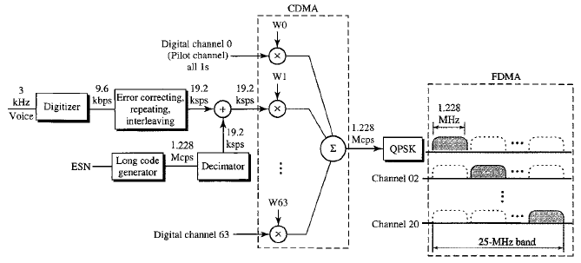
IS-95 forward transmission

Slide 19
Reverse channels use only DSSS as providing synchronization is not feasible (which is required for CDMA).
Each voice channel is digitized, producing data at a rate of 9.6 kbps. However, after adding error-correcting and repeating bits, plus interleaving, the result is a signal of 28.8 ksps. The output is now passed through a 6/64 symbol modulator. The symbols are divided into 6-symbol chunks, and each chunk is interpreted as a binary number (from 0 to 63). The binary number is used as the index to a 64 x 64 Walsh matrix for selection of a row of chips. Each 6-symbol chunk is replaced by a 64-chip code. This provides a kind of orthogonality. The result creates a signal of 307.2 kcps or (28.8/6) x 64.
Next, each chip is spread into 4. Again the ESN of the mobile station creates a long code of 42 bits at a rate of 1.228 Mcps, which is 4 times 307.2.
After spreading, each signal is modulated using QPSK.

Slide 20
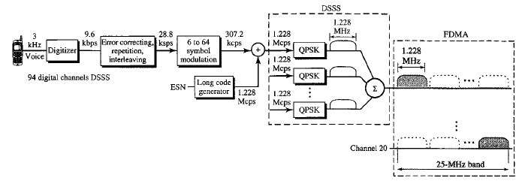
IS-95 reverse transmission
frequency-reuse factor is normally 1.
pilot channels available from its cell and neighboring cells enable a MS to do a soft handoff in contrast to a hard handoff.

Slide 21
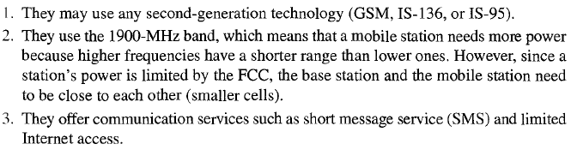
PCS (Personal Communications System)
Does not refer to a single technology such as GSM, IS-136, or IS-95.
It is a generic name for a commercial system that offers several kinds of communication services. Common features of these systems can be summarized:

Slide 22
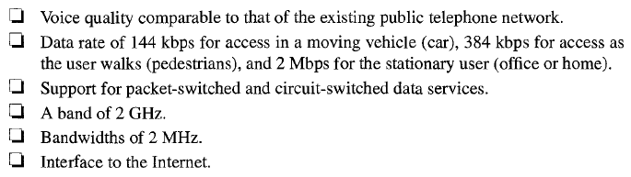
Third Generation
Can provide both digital data and voice communication.
Started in 1992 when ITU issued a blueprint called Internet Mobile Communication (IMT-2000).
Criteria for 3rd generation technology as outlined below:
Main goal of third-generation cellular telephony is to provide universal personal communication.

Slide 23
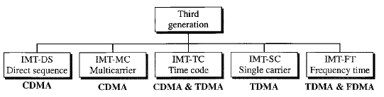
IMT-2000 Radio Interfaces (wireless standards)
All five are developed from second-generation technologies. First two evolved from CDMA technology and so on.
IMT-DS: uses a version of CDMA called wideband CDMA (WCDMA). It uses 5-MHz bandwidth. It is compatible with the CDMA.
IMT-MC: It is known as CDMA-2000. It is an evolution of CDMA and backward compatible with the CDMA. It allows communication on multiple 1.25-MHz channels, up to 15MHz.
IMT-TC: uses a combination of WCDMA and TDMA.

Slide 24
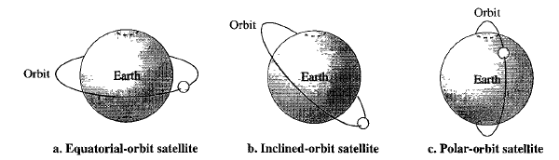
Satellite Networks(1)
A satellite network is a combination of nodes.
A node can be a satellite, an earth station, or an end-user terminal or telephone.
A satellite needs to have an orbit, the path in which it travels around the Earth.
Satellite Orbits

Slide 25

Satellite Networks(2)
The period of a satellite, the time required for a satellite to make a complete trip around the Earth, is determined by Kepler’s law, which defines the period as a function of the distance of the satellite from the center of the earth. Radius of the Earth is 6378Km.
In satellites, line-of-sight(LoS) propagation is used.
The signal from a satellite is normally aimed at a specific area called the footprint. The signal power at the center of the footprint is maximum. Power decreases as we move out from the footprint center.

Slide 26
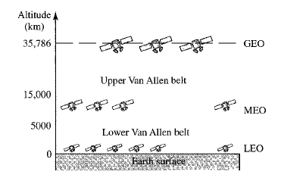
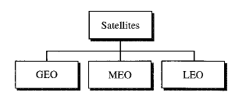
Satellite Networks(3)
Based on the location of the orbit, satellites can be divided into: GEO (Geostationary Earth Orbit), MEO (Middle-Earth-Orbit), LEO (Low-Earth- Orbit).
There is only one orbit, at an altitude of 35,786km for the GEO satellite.
MEO satellites are located at altitudes between 5000 and 15,000km.
LEO satellites are normally below an altitude of 2000km.
A Van Allen belt is a layer that contains charged particles.
Satellite Categories
Satellite Orbit altitudes

Slide 27
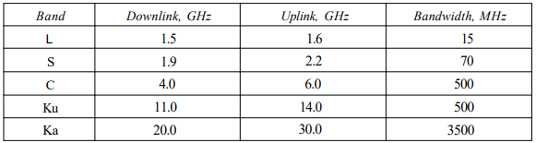
Satellite Networks(4)
Microwave frequencies (GHz) are used for satellites.
Each satellite sends and receives over two different bands.
Transmission from the earth to the satellite is called the uplink.
Transmission from the satellite to the earth is called the downlink.
Satellite Frequency Bands

Slide 28
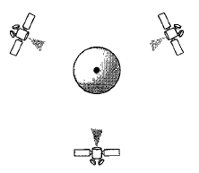
GEO Satellites
In LoS, to ensure constant communication, the satellite must move at the same speed as the Earth so that it seems to remain fixed above a certain spot. Such satellites are called geostationary.
Because orbital speed is based on the distance from the planet, only one orbit can be geostationary. This orbit occurs at the equatorial plane and is approximately 22,000 mi from the surface of the Earth.
Due to curvature of the Earth, one geostationary satellite cannot cover the whole Earth.
Three satellites, each 120º from another in geosynchronous orbit around the equator are shown in fig.

Slide 29
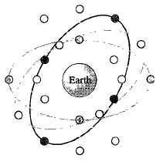
MEO Satellites
take approximately 6-8 hours to circle the Earth.
One example of a MEO satellite system is the Global Positioning System (GPS), orbiting at an altitude about 18,000km above the Earth. It consists of 24 satellites in six orbits and is used for land, sea and air navigation to provide time and locations for vehicles and ships.
The orbits and the locations of the satellites in each orbit are designed in such a way that, at any time, four satellites are visible from any point on Earth.

Slide 30
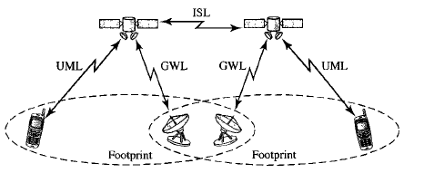
LEO Satellites(1)
Low-Earth-Orbit satellites have polar orbits.
Altitude is between 500 and 2500Km, with a rotation period of 90 to 120 min.
An LEO system usually has a cellular type of access.
An LEO system is made of a constellation of satellites that work together as a network; each satellite acts as a switch. Satellites that are close to each other are connected through intersatellite links (ISLs). A mobile system communicates with the satellite through a user mobile link (UML). A satellite can also communicate with an Earth station (gateway) through a gateway link (GWL).

Slide 31
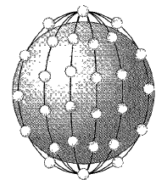

Can be divided into three categories: little LEOs, big LEOs, and broadband LEOs
Little LEOs for low-data-rate messaging.
Globalstar and Iridium systems are examples of big LEOs.
Iridium System
A 77-satellite network, but service was started with 66 satellites in six orbits, 11 satellites in each orbit. The orbits are at an altitude of 750Km.
Iridium is designed to provide direct worldwide voice and data communication using handheld terminals, a service similar to cellular telephony but on a global scale.
Globalstar
It has 48 satellites in six polar orbits with each orbit hosting 8 satellites at an altitude of almost 1400Km. Communication between two distant users in the Iridium system requires relaying between several satellites; Globalstar communication requires both satellites and Earth stations.

Slide 32
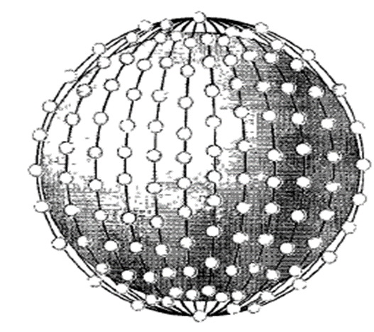
The broadband LEOs provide communication similar to fiber-optic networks. The first broadband LEO system was Teledesic.
Teledesic
Teledesic has 288 satellites in 12 LEO orbits, each at an altitude of 1350Km.
Each orbit hosting 24 satellites.
Its main purpose is to provide broadband Internet access for users all over the world. It is sometimes called “Internet in the sky”.
Transmission occurs in the Ka bands.

